Slide 1
ENGLISH FOR TOURISM
ITENERARY

Slide 2
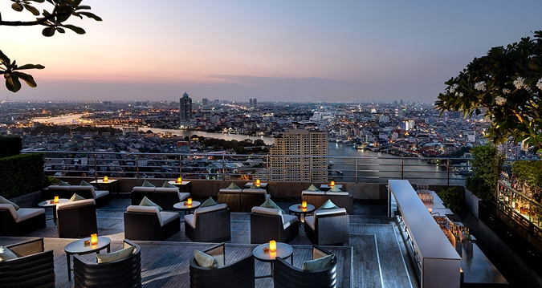
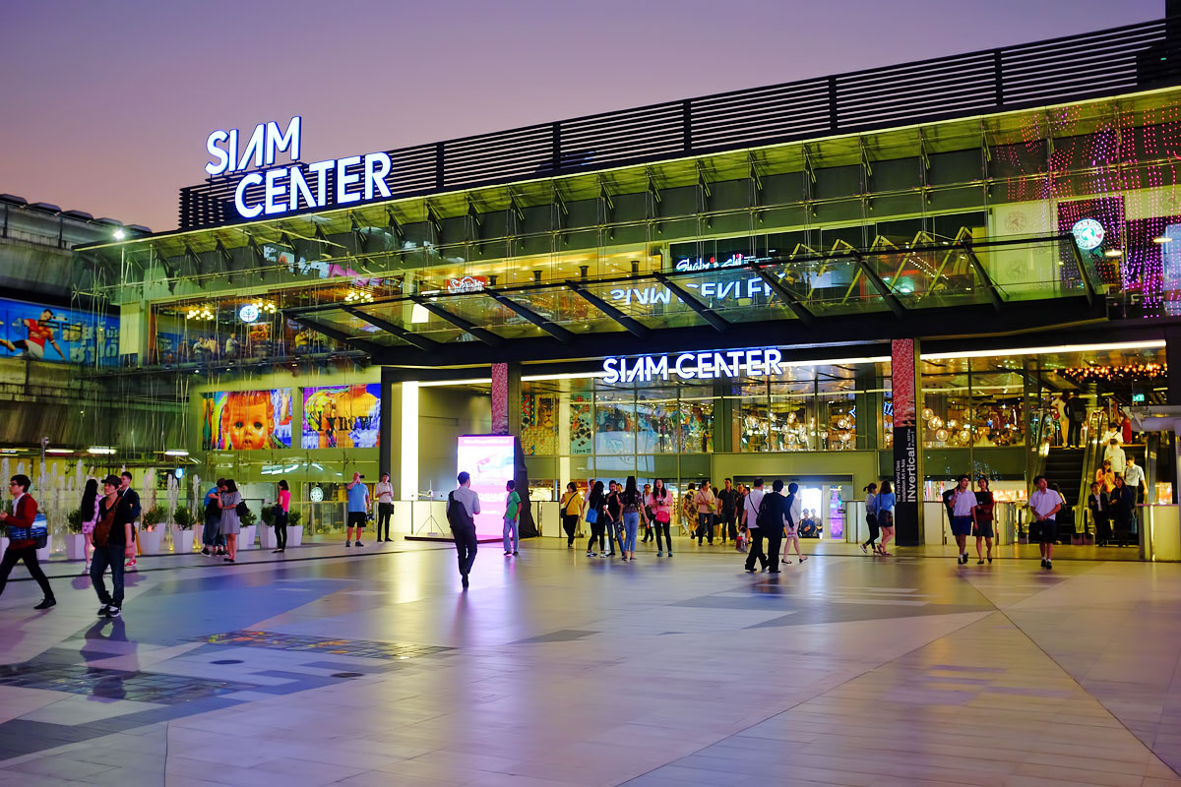
City of Angels ซิตี้ ออฟ แองเจิ้ล

Slide 3
Itenerary ไอทีเนอรารี่
The Ultimate 3 Day Bangkok Itinerary
DAY 1 – The River, Temples, and Historic Sites
After breakfast (at your hotel or a street stall) take the sky train to Saphan Taksin and jump on a ferry from Sathorn/ Central Pier station on the Chao Phraya river (press each image for a bigger version):
DAY 2 – Modern Bangkok, Shopping, and the Cinema
DAY 3 – Silom Area, Lumphini Park, and a Skybar

Slide 4
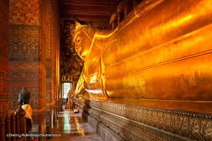
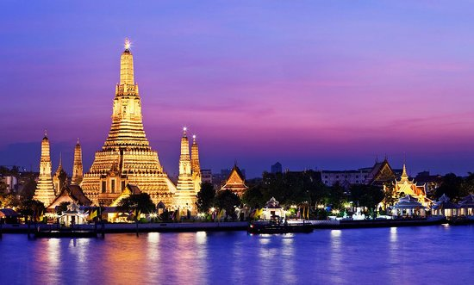
City Tour ซิตี้ ทัวร์

Slide 5
Half Day Tour ฮ๊าฟ เดย์ ทัวร์
9:30am depart from Century Mall (next to BTS Victory Monument Station)
10:00am-11:30am visit The Grand Palace and The Emerald Buhdda (Wat Phra Khaew)
12:00pm-1:30pm Chao Phraya River crossing on a ferry, lunch stop at Wang Lang Market

Slide 6
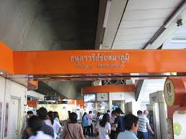
Meeting point มี๊ทติ้ง พ๊อยท์ Depart from ดีพาร์ท ฟรอม
9:30am depart from Century Mall (next to BTS Victory Monument Station)

Slide 7
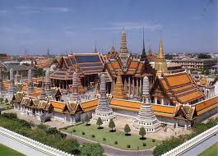
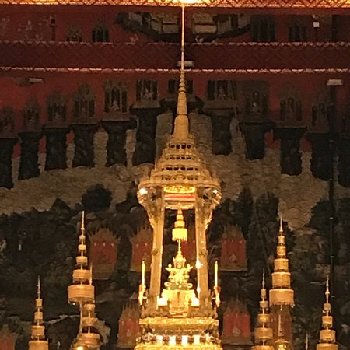
Visit The Grand Palace วิซิท เดอะ แกรนด์ พาเลส
10:00am-11:30am visit The Grand Palace and The Emerald Buhdda (Wat Phra Khaew)
12:00pm-1:30pm Chao Phraya River crossing on a ferry, lunch stop at Wang Lang Market

Slide 8
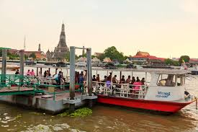
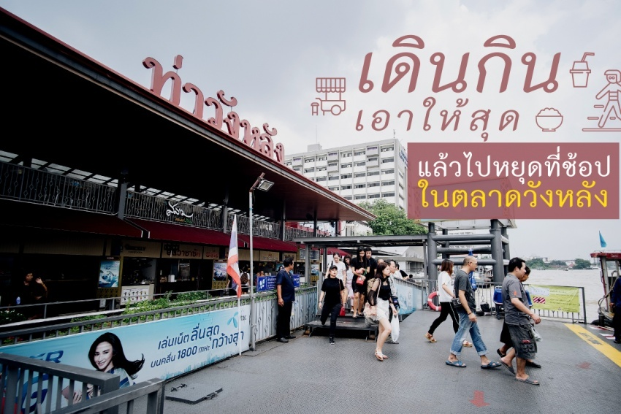
Lunch stop ลั๊นช สต๊อป
12:00pm Chao Phraya River crossing on a ferry, lunch stop at Wang Lang Market

Slide 9
Full Day Tour ฟูล เดย์ ทัวร์

Slide 10
Full Day Tour Itenerary ฟูล เดย์ ทัวร์ ไอทีเนอรารี่
Combine a visit from Bangkok to Ayutthaya — the UNESCO-listed ancient capital of Siam — with a riverboat trip on the Chao Phraya River. An informative guide highlights Thailand’s fascinating history as you explore Ayutthaya temples, stone ruins and Buddha statues in the old capital of Thailand, which was ransacked by invading Burmese in the 18th century. This full-day tour includes lunch and returns you to Bangkok by boat

Slide 11
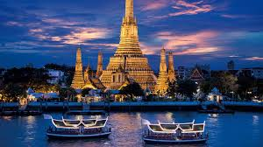
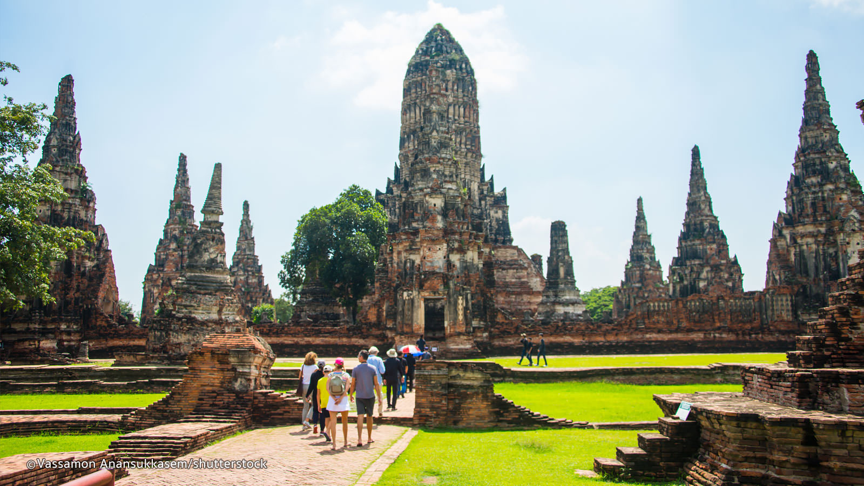
Combine คอมไบน์
Bangkok แบ๊งคอค
Ayudhaya อยุธยา

Slide 12
Ancient แองเชี่ยน

Slide 13
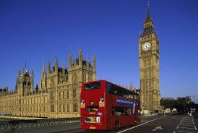
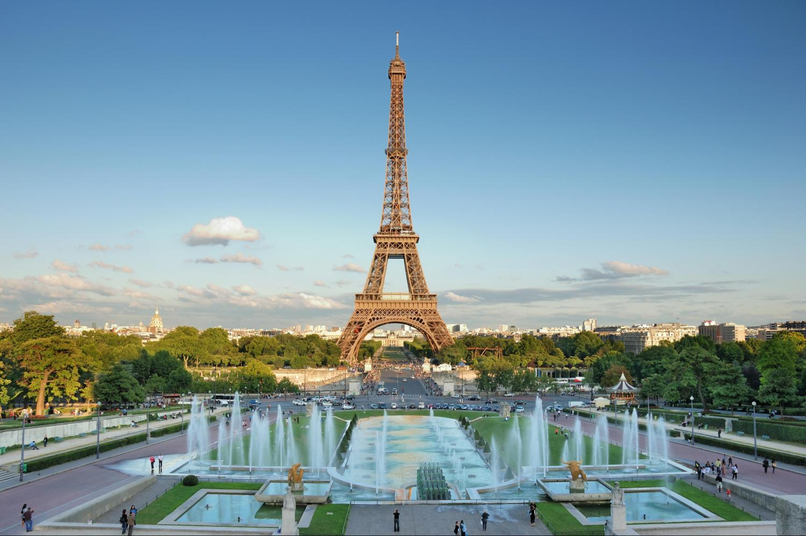
Capital แค๊ปพิทัล

Slide 14
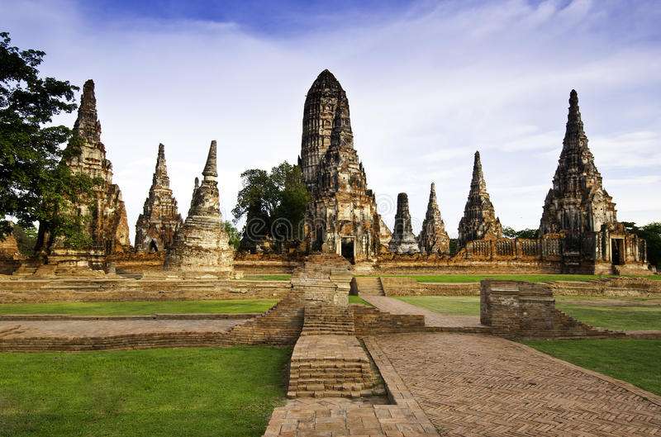
Old Capital โอล แค๊ปพิทัล

Slide 15
River boat trip ริเวอร์โบ๊ท ทริ๊ป

Slide 16
Informative guide อินฟอร์เมทีฟ ไก๊ด์

Slide 17
Highlight ไฮไล๊ท์

Slide 18
Fascinating History ฟั๊สซิเนททิ่ง ฮิสตอรี่

Slide 19
Explore เอ็กซปลอ

Slide 20
Stone ruins สโตน รูน(ส)

Slide 21
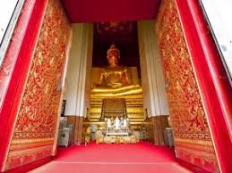
Temple เท็มเพิล

Slide 22
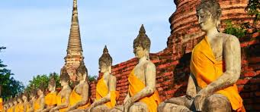
Buddha Statue บุดา สแต๊ะทู

Slide 23
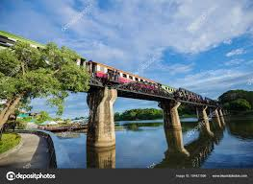
Two days one night tour ทู เดย์ วัน ไน๊ท ทัวร์
River Kwai Bridge
Take a memorable ride on the Thailand–Burma Railway, also known as the Death Railway On this trip from Bangkok, you’ll visit the Kanchanaburi War Cemetery and the death War Museum, Then ride a long-tailed speedboat down the River Kwai where you’ll have a view of the famous bridge. Lunch and hotel transport by coach are included. Stay over night at a resort. Relaxing day before return to Bangkok.

Slide 24
Two days one night tour ทู เดย์ วัน ไน๊ท์ ทัวร์
TOUR ITINERARY
Day 1: Bangkok to River kwai ( L, D)
06.00-06.30 - Pick up from hotel in Bangkok. Depart to Kanchnaburi province
09.00 - Arrive Kanchanaburi province.
- Visit Thailand–Burma Railway Centre an interactive museum, information and research facility dedicated to presenting the history of the Thailand– Burma Railway. The fully air–conditioned center offers the visitor an educational and moving experience
-Visit Allied War Cemetery which is memorial to some 6000 allied prisoners of war (POWs) who perished along the death railway line and were moved post-war to this eternal resting place.
-Visit the world famous Bridge over the River Kwai, a part of Death Railway constructed by Allied POWs

Slide 25
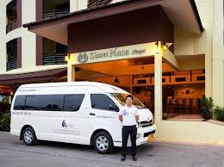
Pick up from hotel พิ๊ค อัพ ฟรอม โฮเทล

Slide 26
Depart to Karnchanaburi province ดีพาร์ท ทู กาญจนบุรี โพรวิ๊นซ์

Slide 27
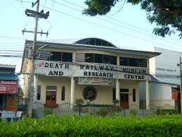
Interactive museum อินเทอร์ แอ๊ททีฟ มิวเซี่ยม
09.00 - Arrive Kanchanaburi province.
- Visit Thailand–Burma Railway Centre an interactive museum, information and research facility dedicated to presenting the history of the Thailand– Burma Railway.

Slide 28
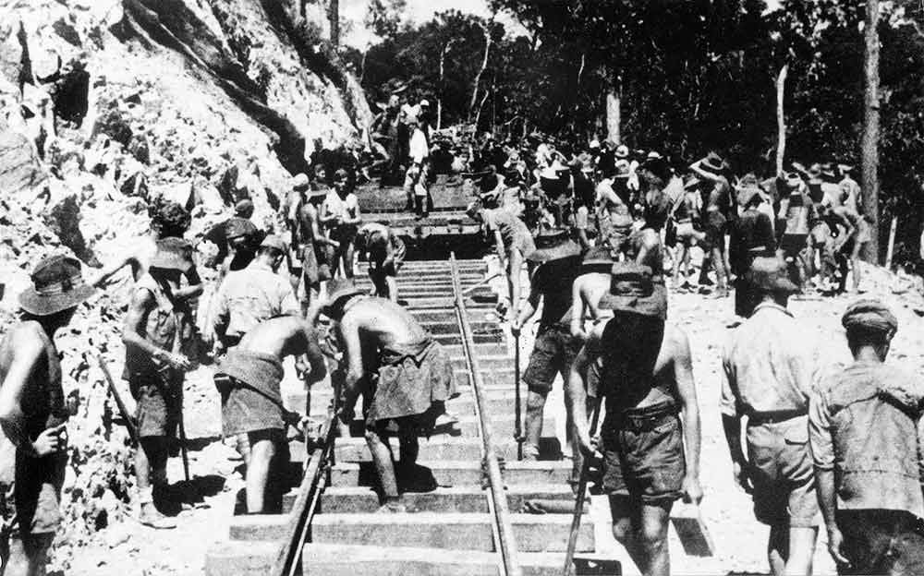
Prisoner of war พริเชิ่นเนอร์ ออฟ วอร์
Visit Allied War Cemetery which is memorial to some 6000 allied prisoners of war (POWs) who perished along the death railway line and were moved post-war to this eternal resting place

Slide 29
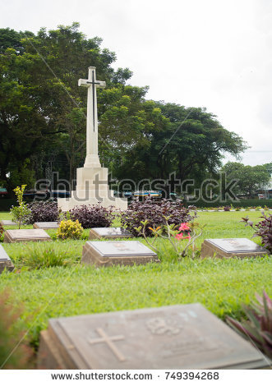
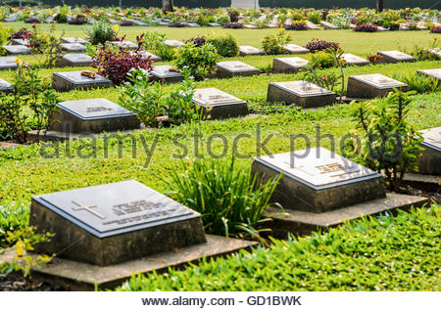
War Cemetery วอร์ เซเมเทอรี่

Slide 30
Bridge over the River Kwai บริดจ โอเวอร์ เดอะ รีเวอร์ แคว
Visit the world famous Bridge over the River Kwai, a part of Death Railway constructed by Allied POWs

Slide 31
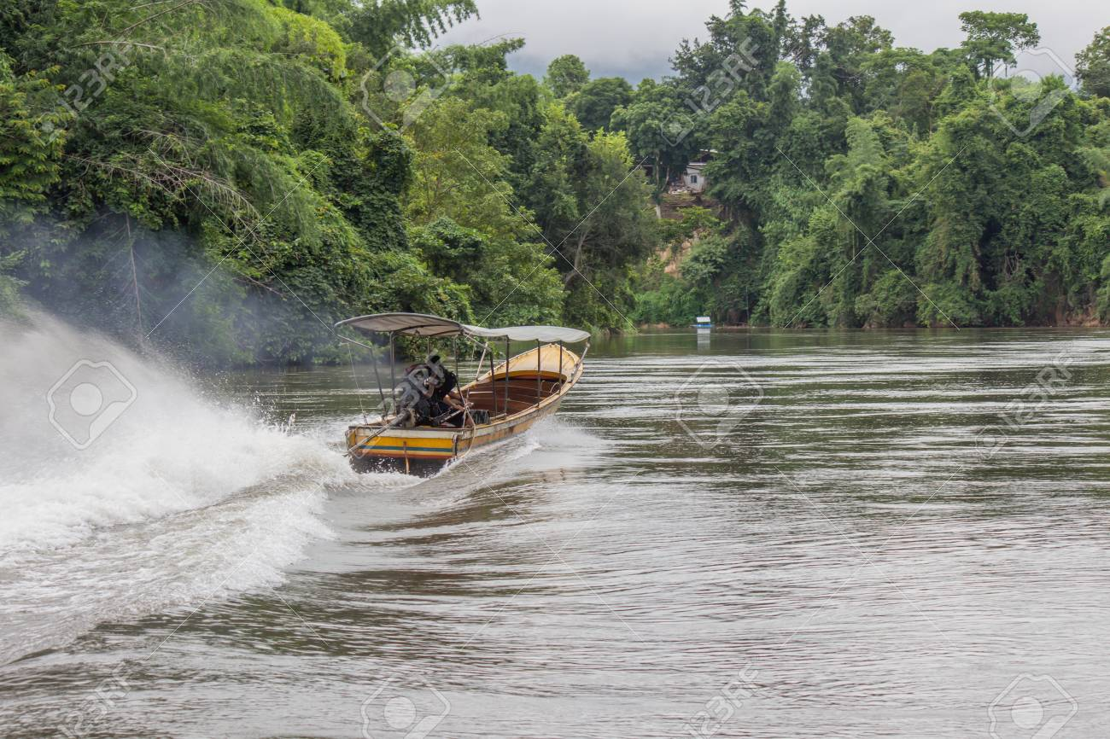
Long tail boat ลอง เทล โบ๊ท
12.00 - Take a long–tailed boat on River Kwai to the resort.. Check–in and have Lunch upon arrival.

Slide 32
Check- in เช็ค อิน

Slide 33
Lunch upon arrival ลั๊นช อะพอน อะไร๊บวอล

Slide 34
Upstream อัพ สตรีม
14.45 - Take a long–tailed boat upstream to visit nearby ethnic Mon Tribal Village & Temple. Then return to the hotel

Slide 35
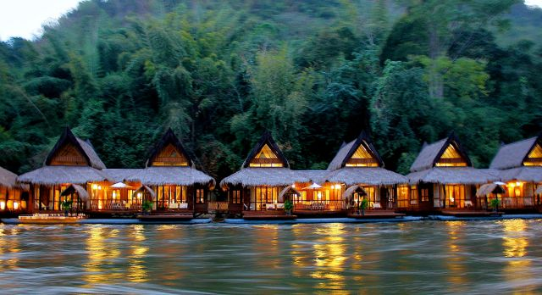
Over night โอเวอร์ ไน๊ท
19.00 - Dinner, followed by a 45-minute presentation of Mon Dance and overnight

Slide 36
Down stream ดาวน์ สตรีม
Day 2: River Kwai - Bangkok (B,L)
07.00 - Breakfast.
08.30 -Take a long–tailed boat downstream to Resotel Pier and continue on road to visit the Hellfire Pass Memorial.
11.00 - Check-out
11.40 - Lunch at local restaurant.
13.00 - Take a historic ride on Death Railway Train passing over original wooden viaduct constructed by Allied POWs
14.30 - Journey back to Bangkok.
18.00 - Arrive Bangkok and transfer to hotels.

Slide 37
Continue on road คอนทีนิว ออน โร๊ด

Slide 38
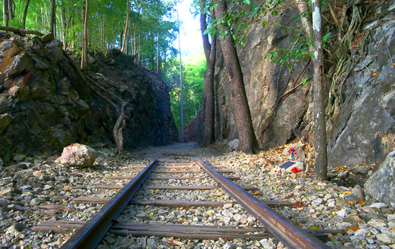
Hell Fire Pass Memorial เฮล ไฟร์ พาส เมโมเรียล

Slide 39
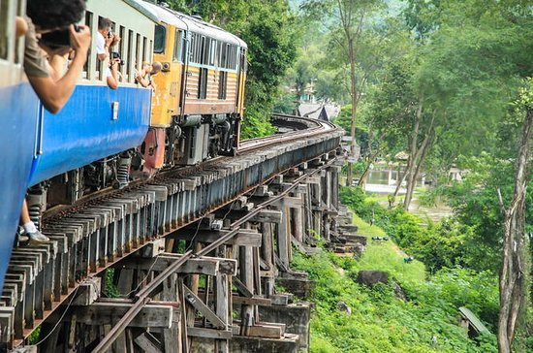
Death RailwayTrain เด็ธซ เร็ลเวร์ เทรน
13.00 - Take a historic ride on Death Railway Train passing over original wooden viaduct

Slide 40
Wooden Viaduct วู๊ดเดิ้ล วายดัก

Slide 42
City of Angels ซิตี้ ออฟ แองเจิ้ล

Slide 43
The Ultimate 3 Day Bangkok Itinerary
DAY 1 – The River, Temples, and Historic Sites
After breakfast (at your hotel or a street stall) take the sky train to Saphan Taksin and jump on a ferry from Sathorn/ Central Pier station on the Chao Phraya river (press each image for a bigger version):
DAY 2 – Modern Bangkok, Shopping, and the Cinema
DAY 3 – Silom Area, Lumphini Park, and a Skybar

Slide 44
Itenerary ไอทีเนอรารี่
The Ultimate 3 Day Bangkok Itinerary
DAY 1 – The River, Temples, and Historic Sites
After breakfast (at your hotel or a street stall) take the sky train to Saphan Taksin and jump on a ferry from Sathorn/ Central Pier station on the Chao Phraya river (press each image for a bigger version):
DAY 2 – Modern Bangkok, Shopping, and the Cinema
DAY 3 – Silom Area, Lumphini Park, and a Skybar

Slide 46
City Tour ซิตี้ ทัวร์

Slide 47
9:30am depart from Century Mall (next to BTS Victory Monument Station)
10:00am-11:30am visit The Grand Palace and The Emerald Buhdda (Wat Phra Khaew)
12:00pm-1:30pm Chao Phraya River crossing on a ferry, lunch stop at Wang Lang Market

Slide 48
Half Day Tour ฮ๊าฟ เดย์ ทัวร์
9:30am depart from Century Mall (next to BTS Victory Monument Station)
10:00am-11:30am visit The Grand Palace and The Emerald Buhdda (Wat Phra Khaew)
12:00pm-1:30pm Chao Phraya River crossing on a ferry, lunch stop at Wang Lang Market

Slide 49
9:30am depart from Century Mall (next to BTS Victory Monument Station)

Slide 50
Meeting point มี๊ทติ้ง พ๊อยท์ Depart from ดีพาร์ท ฟรอม
9:30am depart from Century Mall (next to BTS Victory Monument Station)

Slide 51
10:00am-11:30am visit The Grand Palace and The Emerald Buhdda (Wat Phra Khaew)
12:00pm-1:30pm Chao Phraya River crossing on a ferry, lunch stop at Wang Lang Market

Slide 52
Visit The Grand Palace วิซิท เดอะ แกรนด์ พาเลส
10:00am-11:30am visit The Grand Palace and The Emerald Buhdda (Wat Phra Khaew)
12:00pm-1:30pm Chao Phraya River crossing on a ferry, lunch stop at Wang Lang Market

Slide 53
12:00pm Chao Phraya River crossing on a ferry, lunch stop at Wang Lang Market

Slide 54
Lunch stop ลั๊นช สต๊อป
12:00pm Chao Phraya River crossing on a ferry, lunch stop at Wang Lang Market

Slide 56
Full Day Tour ฟูล เดย์ ทัวร์

Slide 57
Combine a visit from Bangkok to Ayutthaya — the UNESCO-listed ancient capital of Siam — with a riverboat trip on the Chao Phraya River. An informative guide highlights Thailand’s fascinating history as you explore Ayutthaya temples, stone ruins and Buddha statues in the old capital of Thailand, which was ransacked by invading Burmese in the 18th century. This full-day tour includes lunch and returns you to Bangkok by boat

Slide 58
Full Day Tour Itenerary ฟูล เดย์ ทัวร์ ไอทีเนอรารี่
Combine a visit from Bangkok to Ayutthaya — the UNESCO-listed ancient capital of Siam — with a riverboat trip on the Chao Phraya River. An informative guide highlights Thailand’s fascinating history as you explore Ayutthaya temples, stone ruins and Buddha statues in the old capital of Thailand, which was ransacked by invading Burmese in the 18th century. This full-day tour includes lunch and returns you to Bangkok by boat

Slide 60
Combine คอมไบน์
Bangkok แบ๊งคอค
Ayudhaya อยุธยา

Slide 62
Ancient แองเชี่ยน

Slide 64
Capital แค๊ปพิทัล

Slide 66
Old Capital โอล แค๊ปพิทัล

Slide 68
River boat trip ริเวอร์โบ๊ท ทริ๊ป

Slide 70
Informative guide อินฟอร์เมทีฟ ไก๊ด์

Slide 72
Highlight ไฮไล๊ท์

Slide 74
Fascinating History ฟั๊สซิเนททิ่ง ฮิสตอรี่

Slide 76
Explore เอ็กซปลอ

Slide 78
Stone ruins สโตน รูน(ส)

Slide 80
Temple เท็มเพิล

Slide 82
Buddha Statue บุดา สแต๊ะทู

Slide 84
Two days one night tour ทู เดย์ วัน ไน๊ท ทัวร์
River Kwai Bridge
Take a memorable ride on the Thailand–Burma Railway, also known as the Death Railway On this trip from Bangkok, you’ll visit the Kanchanaburi War Cemetery and the death War Museum, Then ride a long-tailed speedboat down the River Kwai where you’ll have a view of the famous bridge. Lunch and hotel transport by coach are included. Stay over night at a resort. Relaxing day before return to Bangkok.

Slide 85
TOUR ITINERARY
Day 1: Bangkok to River kwai ( L, D)
06.00-06.30 - Pick up from hotel in Bangkok. Depart to Kanchnaburi province
09.00 - Arrive Kanchanaburi province.
- Visit Thailand–Burma Railway Centre an interactive museum, information and research facility dedicated to presenting the history of the Thailand– Burma Railway. The fully air–conditioned center offers the visitor an educational and moving experience
-Visit Allied War Cemetery which is memorial to some 6000 allied prisoners of war (POWs) who perished along the death railway line and were moved post-war to this eternal resting place.
-Visit the world famous Bridge over the River Kwai, a part of Death Railway constructed by Allied POWs

Slide 86
Two days one night tour ทู เดย์ วัน ไน๊ท์ ทัวร์
TOUR ITINERARY
Day 1: Bangkok to River kwai ( L, D)
06.00-06.30 - Pick up from hotel in Bangkok. Depart to Kanchnaburi province
09.00 - Arrive Kanchanaburi province.
- Visit Thailand–Burma Railway Centre an interactive museum, information and research facility dedicated to presenting the history of the Thailand– Burma Railway. The fully air–conditioned center offers the visitor an educational and moving experience
-Visit Allied War Cemetery which is memorial to some 6000 allied prisoners of war (POWs) who perished along the death railway line and were moved post-war to this eternal resting place.
-Visit the world famous Bridge over the River Kwai, a part of Death Railway constructed by Allied POWs

Slide 88
Pick up from hotel พิ๊ค อัพ ฟรอม โฮเทล

Slide 90
Depart to Karnchanaburi province ดีพาร์ท ทู กาญจนบุรี โพรวิ๊นซ์

Slide 91
09.00 - Arrive Kanchanaburi province.
- Visit Thailand–Burma Railway Centre an interactive museum, information and research facility dedicated to presenting the history of the Thailand– Burma Railway.

Slide 92
Interactive museum อินเทอร์ แอ๊ททีฟ มิวเซี่ยม
09.00 - Arrive Kanchanaburi province.
- Visit Thailand–Burma Railway Centre an interactive museum, information and research facility dedicated to presenting the history of the Thailand– Burma Railway.

Slide 93
Visit Allied War Cemetery which is memorial to some 6000 allied prisoners of war (POWs) who perished along the death railway line and were moved post-war to this eternal resting place

Slide 94
Prisoner of war พริเชิ่นเนอร์ ออฟ วอร์
Visit Allied War Cemetery which is memorial to some 6000 allied prisoners of war (POWs) who perished along the death railway line and were moved post-war to this eternal resting place

Slide 96
War Cemetery วอร์ เซเมเทอรี่

Slide 97
Visit the world famous Bridge over the River Kwai, a part of Death Railway constructed by Allied POWs

Slide 98
Bridge over the River Kwai บริดจ โอเวอร์ เดอะ รีเวอร์ แคว
Visit the world famous Bridge over the River Kwai, a part of Death Railway constructed by Allied POWs

Slide 99
12.00 - Take a long–tailed boat on River Kwai to the resort.. Check–in and have Lunch upon arrival.

Slide 100
Long tail boat ลอง เทล โบ๊ท
12.00 - Take a long–tailed boat on River Kwai to the resort.. Check–in and have Lunch upon arrival.

Slide 102
Check- in เช็ค อิน

Slide 104
Lunch upon arrival ลั๊นช อะพอน อะไร๊บวอล

Slide 105
14.45 - Take a long–tailed boat upstream to visit nearby ethnic Mon Tribal Village & Temple. Then return to the hotel

Slide 106
Upstream อัพ สตรีม
14.45 - Take a long–tailed boat upstream to visit nearby ethnic Mon Tribal Village & Temple. Then return to the hotel

Slide 107
19.00 - Dinner, followed by a 45-minute presentation of Mon Dance and overnight

Slide 108
Over night โอเวอร์ ไน๊ท
19.00 - Dinner, followed by a 45-minute presentation of Mon Dance and overnight

Slide 109
Day 2: River Kwai - Bangkok (B,L)
07.00 - Breakfast.
08.30 -Take a long–tailed boat downstream to Resotel Pier and continue on road to visit the Hellfire Pass Memorial.
11.00 - Check-out
11.40 - Lunch at local restaurant.
13.00 - Take a historic ride on Death Railway Train passing over original wooden viaduct constructed by Allied POWs
14.30 - Journey back to Bangkok.
18.00 - Arrive Bangkok and transfer to hotels.

Slide 110
Down stream ดาวน์ สตรีม
Day 2: River Kwai - Bangkok (B,L)
07.00 - Breakfast.
08.30 -Take a long–tailed boat downstream to Resotel Pier and continue on road to visit the Hellfire Pass Memorial.
11.00 - Check-out
11.40 - Lunch at local restaurant.
13.00 - Take a historic ride on Death Railway Train passing over original wooden viaduct constructed by Allied POWs
14.30 - Journey back to Bangkok.
18.00 - Arrive Bangkok and transfer to hotels.

Slide 112
Continue on road คอนทีนิว ออน โร๊ด

Slide 114
Hell Fire Pass Memorial เฮล ไฟร์ พาส เมโมเรียล

Slide 115
13.00 - Take a historic ride on Death Railway Train passing over original wooden viaduct

Slide 116
Death RailwayTrain เด็ธซ เร็ลเวร์ เทรน
13.00 - Take a historic ride on Death Railway Train passing over original wooden viaduct

Slide 118
Wooden Viaduct วู๊ดเดิ้ล วายดัก

